Slide 1
Part 3: Demos & Learning

Slide 2
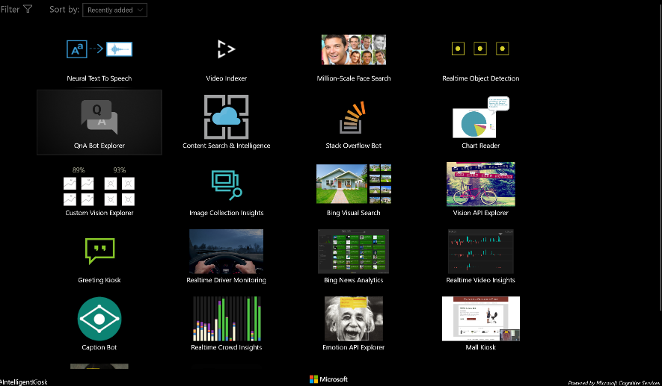
Intelligent Kiosk
Install Intelligent Kiosk App: link, http://aka.ms/mag/kiosk

Slide 3
Custom Vision
https://www.customvision.ai
Build an image classification model that can recognise driving license and passport images
Maybe some OCR

Slide 4
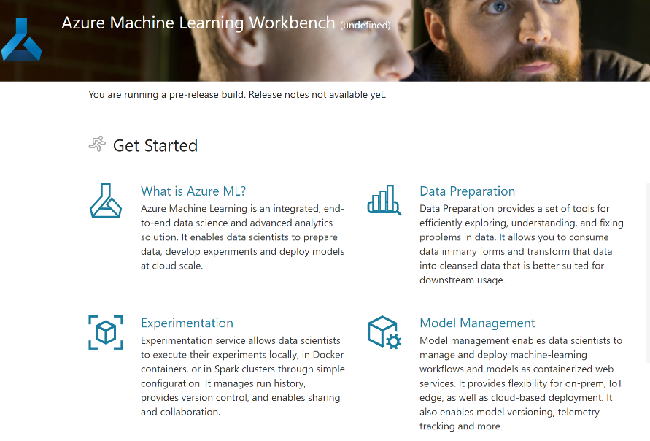
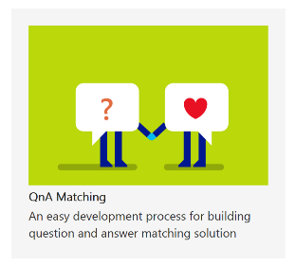
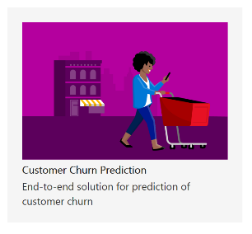
Azure Machine Learning Workbench
Notes:
The AI Machine Learning brings together all of the tools you need to prepare your data, build experiments and manage your models
http://azureml.azureedge.net/content/apphome/index.html

Slide 5


Machine learning on Azure
Sophisticated pretrained models
To simplify solution development
Vision
Speech
Language
Search
Popular frameworks
To build advanced deep learning solutions
Pytorch
TensorFlow
Keras
Onnx
Productive services
To empower data science and development teams
Azure Databricks
Azure Machine Learning
Machine Learning VMs
Powerful infrastructure
To accelerate deep learning
CPU
GPU
FPGA
Flexible deployment
To deploy, manage models on intelligent cloud & edge
On-premises
Cloud
Edge

Slide 6
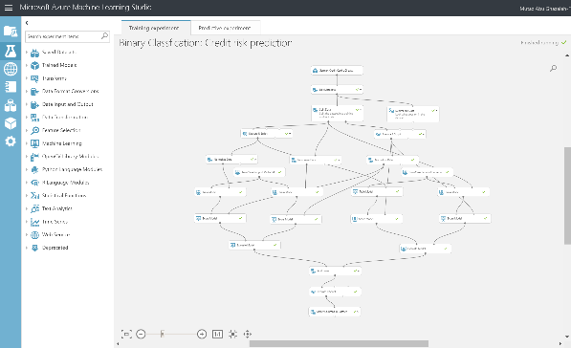
Machine Learning Demo
Credit Risk Prediction – Binary Classification
https://gallery.azure.ai/Experiment/Binary-Classfication-Credit-risk-prediction-5

Slide 7

Azure Machine Learning
Automated machine learning
Hyper parameter tuning
Distributed deep learning
New FPGA-powered models
Deployment to Azure, on-premises & IoT edge
Python SDK

Slide 8
Azure Machine Learning Automated machine learning
How much is this car worth?

Slide 9
Model creation is typically a time consuming process
Which features?
Which algorithm?
Which parameters?
Mileage
Condition
Car brand
Year of make
Regulations
…
Gradient Boosted
Nearest Neighbors
SVM
Bayesian Regression
LGBM
…
Parameter 1
Parameter 2
Parameter 3
Parameter 4
…
Mileage
Gradient Boosted
Criterion
Loss
Min Samples Split
Min Samples Leaf
Others
Car brand
Year of make
30%
Model

Slide 10
Model creation is typically a time consuming process
Which features?
Which algorithm?
Which parameters?
Mileage
Condition
Car brand
Year of make
Regulations
…
Gradient Boosted
Nearest Neighbors
SVM
Bayesian Regression
LGBM
…
Criterion
Loss
Min Samples Split
Min Samples Leaf
Others
Mileage
Gradient Boosted
N Neighbors
Weights
Metric
P
Others
Condition
Nearest Neighbors
Car brand
Car brand
50%
Year of make
30%
Year of make
Model
Iterate

Slide 11
Model creation is typically a time consuming process
Which features?
Which algorithm?
Which parameters?
30%
50%
70%
30%
45%
50%
65%
95%
35%
10%
75%
20%
70%
30%
15%
Iterate

Slide 12
Azure Machine Learning accelerates model development with automated machine learning
Input
Intelligently test multiple models in parallel
Output
25%
Optimized model
25%
40%
Enter data
70%
25%
40%
70%
95%
95%
Define goals
25%
40%
70%
25%
40%
25%
70%
Apply constraints
40%

Slide 13
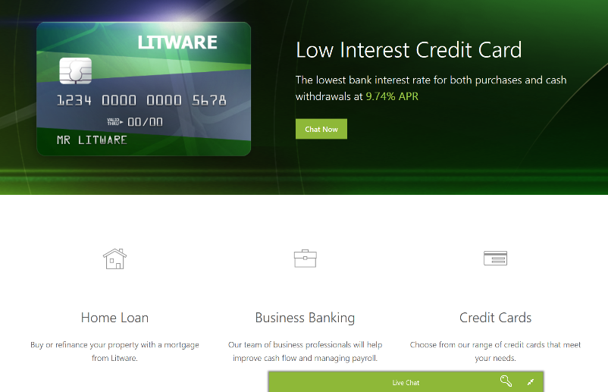
Litware Bank Demo
Litware Bank Demo: link
Notes:
Username: Bot
Password: Azure
Lance Olson
Customer ID: ****

Slide 14
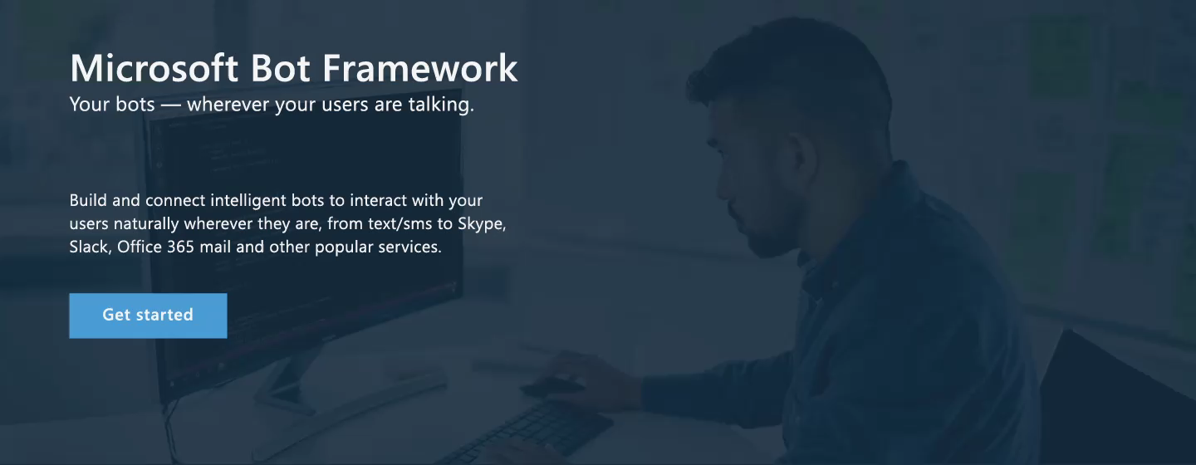
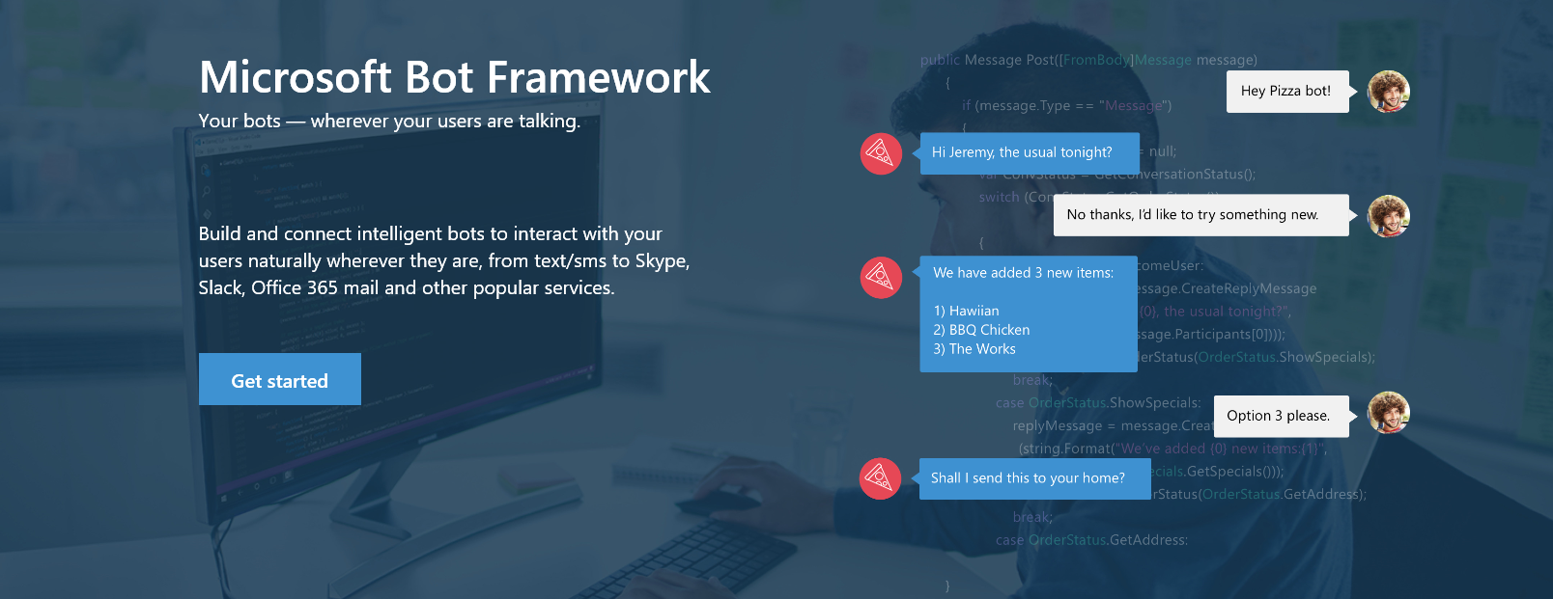


www.botframework.com
Notes:
I want to introduce the Microsoft bot framework. This is available to anyone and incredibly user friendly. We’ve had lots of the team play around with this in the offices trying various platforms. I recommend visiting that site bot framework and doing some exploration.

Slide 15
Bing image search
Speech API
Entity linking
Customer feedback analysis
Bing news search
Speech
Text to speech
Custom recognition (CRIS)
Forecasting
Language
Recommendation API
Machine Learning
Text analytics
Thumbnail generation
Cognitive Services APIs
Academic knowledge
Spell check
Web language model
Knowledge
Bing autosuggest
Computer vision
Vision
Emotion
Anomaly detection
Sentiment scoring
Search
OCR, tagging, captioning
Bing web search

Slide 16

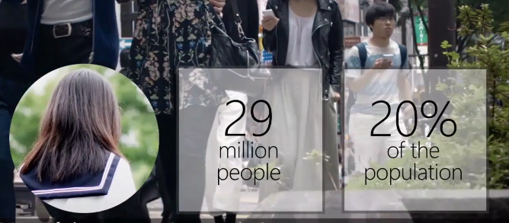
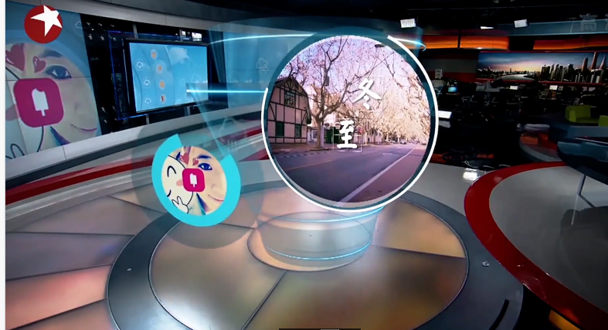
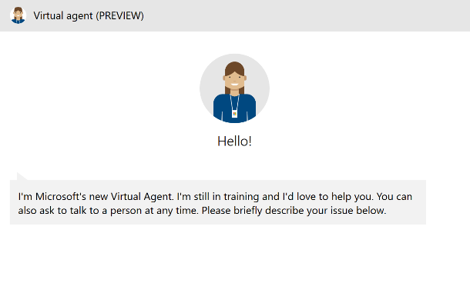
Notes:
Now meet Xiaolce (Showice) – Xioalce is a celebrity in China – she has 40 million friends who she delights with friendship and conversation. Xioalce even recently started reading the weather nightly as a guest anchor on one of Chinas largest new stations.
Xiaolce is a machine learning bot who was created in a Microsoft hackathon, and after being integrated into WeChat, practically overnight she has become one of Weibo’s top influencer.
She is special because she cares. She has a balanced IQ and EQ which enables her to form strong relationships with human being. She’s funny, informative and sensitive to emotions, remembering your previous chats. If you tell her about a breakup, she’ll check in with you.
And the data show that these are deep interactions. What we learned from Xioice is that people want their tech to be approachable and to adjust to the way we communicate.
https://support.microsoft.com/en-us/contact/virtual-agent/
https://www.microsoft.com/en-us/research/project/health-bot/
https://blogs.msdn.microsoft.com/stevengu/2017/09/25/introducing-dynamics-365-ai-solutions/

Slide 17












Conversational AI: Azure Bot Service + Cognitive Services
User Input
Channels
Bot Intelligence
Business Process
Start
LOB Apps
Transition 1
Transition 2
Leveraging existing data assets
Bing Search
State 1
State 2
Text
Custom AI Models
Transition 3
Speech
Transition 4
State 3
Bot Framework SDK Dialog manager
On premise
Speech
IFTTT
Enterprise stores
QnA Maker
Dispatch
Image
Translator
Language understanding
Azure Tools
Security
Logging
Auditing
Integration

Slide 18
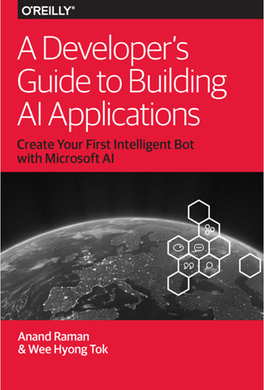
https://azure.microsoft.com/sv-se/blog/how-developers-can-get-started-with-building-ai-applications/
Notes:
Create your first intelligent bot with Microsoft AI.
Artificial intelligence (AI) is accelerating the digital transformation for every industry, with examples spanning manufacturing, retail, finance, healthcare and many others. At this rate, every industry will be able to use AI to amplify human ingenuity. In this eBook, Anand Raman and Wee Hyong Tok from Microsoft provide a comprehensive roadmap for developers to build their first AI-infused application.
Using a Conference Buddy as an example, you’ll learn the key ingredients needed to develop an intelligent chatbot that helps conference participants interact with speakers. This eBook provides a gentle introduction to the tools, infrastructure and services on the Microsoft AI Platform, and teaches you how to create powerful, intelligent applications.
Understand how the intersection of cloud, data and AI is enabling organisations to build intelligent systems.
Learn the tools, infrastructure and services available as part of the Microsoft AI Platform for developing AI applications.
Teach the Conference Buddy application new AI skills, using pre-built AI capabilities such as vision, translation and speech.
Learn about the Open Neural Network Exchange.

